Slide 1

Week 2
Good job handing in your homework on time. This is a learning experience. You can hand your homework in again, but read the comments carefully and ask questions on THURSDAY.
Research: Part 1: Citations and References page APA style
Remember iPhone = no name FA 24
Entry Participation Task in 10 minutes

Slide 2

Assignment 1 Homework Feedback
Homework and Assignment Tip:
Read the prompt or instructions carefully before starting and then again when you finish to make sure you answered correctly..

Slide 3
Writing assignments: Be specific in your answers and check any rubric and comments
The objective is to work on writing clear, effective paragraph answers to a homework or test question.
If you did not get 5/5, read the comments in the margin and in the text box.
You can resubmit two times, but ask questions first.

Slide 4
Format for a short answer: 1 point on the rubric: echo and indent
Must be one paragraph. This is what the instructions specified, along with a suggested sentence length. (-1)
Should mention or repeat the question in some way in the first sentence and references the source, if there is one. This is what "echoes" means. According to the video, one cultural difference is or In the video, a cultural difference is … The video mentions several cultural differences, but one....(-0.5 next time.)
Indent your paragraph. In indent means to start the first sentence 5 - 7 spaces in from the margin. (-0.5) Like this:
The video gives several pieces of good advice for how to find a keyword when you do any research. First of all, look for synonyms and academic terms that are related to your topic....

Slide 5
Indent at the beginning
At the beginning of paragraphs, indent 5 or 7 spaces. Do not use the tab key because that is too much. This is part of the APA style of writing. To indent means to move in 5 or 7 spaces. This will be part of the format for future assignments. Example:
What are the four cultural values listed on page 58? Explain why they are important.
Answer in homework:
1.
The four cultural values on page 58 are individualism, personal responsibility, freedom of choice, and independent thinking. They ….

Slide 6
Topic Sentence = echoing the prompt
When you echo the prompt, (repeat key words), you are making a topic sentence. Most paragraphs have topic sentences which tell the reader what that paragraph is mainly about. This helps the reader read more quickly and efficiently. It makes your writing clearer.

Slide 7
Plagiarism: Automatic 0
Do not copy the prompt or questions in your answer directly because this makes it look like plagiarism. These are short answers and the prompt may be longer than the answer. This could be up to 50% on Turnitin. You may receive an automatic 0 if the score is over 30% on your homework, so check yourself and resubmit if necessary.
Under 20% is okay.

Slide 8
Do NOT copy the prompt
This is a short answer, so if you copy the prompt, your Turnitin score can be very high.
So, this makes it look like plagiarism. If it is between 20 - 30%, I will look at the report and decide how many points to take off.
Each time I have to look, it takes a minute or more of extra time for grading.
If it is over 30%, I will not look and you get a 0. It may just be the copied prompt, but anything in red probably means copied sections from another student or online source. You can rewrite and resubmit.

Slide 9
Example of a short answer as a paragraph:
2.
The video showed several aspects of the U.S. academic culture that surprised me. In Mexico, students usually cannot talk to a teacher using the first name. Titles of respect are very important, along with other aspects of the Spanish language that show respect. My advice to any U.S. students going to study in a Mexican university is to use Dr. Or Licenciado any time they talk to a professor and to always use usted instead of tú, which is the formal form of "you." This way they can avoid offending a professor.
(A paragraph can be almost ½ page long in some cases. No lists or numbers or bullets.)

Slide 10
IN ? Which COUNTRY OR CULTURE?
Be specific. Don't use general or vague references.
The question was about comparing the academic university culture or classroom with the same thing in your culture, but how is the reader supposed to know what culture? You are going to learn more about your own culture while comparing to the U.S. culture, both general and academic.
Never assume the reader knows anything about the topic. You, as the writer, must give all needed information. This is called the "direct" style of writing.

Slide 11

Participation Entry Task 2 Reminder: 5 minutes 1) Read everything carefully. 2) Careful with ones that say "all of the following except."
Class is all of the following except : a) on Tuesday b) on zoom c) not required d) mandatory
Correct answer is _____

Slide 12
Today's Objectives:
Talk about "academic" language in emails and assignments.
Explain what major differences are between APA and MLA styles.
Explain what in-text citations are and their format.
Explain how to make a References page.
Show the Book vs. Journal article format for in-text and References citations.

Slide 13
Academic language and Style in Research
Research papers and case studies use academic language and style. They avoid the use of the personal "I" or "In my opinion" or "I think." You can use these phrases in Reflection papers or short answers, when the teacher asks for your opinion.
They use an academic style of citation, vocabulary and punctuation.
They document sources by using citation and a References page or Works Cited page.
Vocabulary does not have to be exotic. For example, do not use "kids", which is informal for children , but "progeny" is too formal. "Children" is the best.

Slide 14
Emailing your professors
What advice did the homework page give?
Some other things to avoid:
Phrases like: "Please do this as soon as possible."
"Correct this at your earliest convenience." (These
phrases sound like you are either the boss or a
client, and neither of these are the correct relationship.)
"Thank u for your help" (use correct grammar)
My preference: Dear (Dr. Pascoe, Professor Pascoe, Diana, she/her)

Slide 15

Whole group question:
Do you have to do any research papers or projects or presentations?
What style was used in your university? MLA, APA, Turabian, CMS or other

Slide 16

Research Part 1: Citations
What is a citation?
Do you need to memorize citation style?
What are the most commonly used citation styles at Webster University in the Business School?
What resources can you use to improve your citation skills?

Slide 17

Citing = Documenting Sources
To cite is to document the sources of the information you use in papers, presentations, power points, etc.
Citation styles have handbooks or style guides, such as the APA, MLA, Turabian, Chicago Manual, etc.

Slide 18
What is citation? Why does it exist?
Citation is the system of formatting that academic writers use to indicate the source of the ideas, visuals, audio that they have used in their academic writing or presentations.
Any time you use someone else's ideas or work in your work, you need to cite them.
This includes paraphrases, which is putting ideas into your own words.
It exists to give credit where credit is due. In US academic writing, it’s not ethical to use another person’s work as if it is you own.

Slide 19
When to cite
Any time you have information that is specific, refers to someone's work or contains numbers, examples or information that is not general knowledge.
There should be no personal opinions in a research paper, so everything except for general knowledge is cited.
There are two types of citation:
In-text citation : when the source is mentioned in the body of the work. Ex: LaScotte and Peters (2021) mention....... (p. 58).
In the References page: a list of sources at the end of the paper.

Slide 20


What are the two most used citation styles at Webster?
APA – American Psychological Association: Business School
MLA – Modern Language Association: Arts, Humanities, Languages
Use depends on area of study and/or professor preference
MLA | APA
Works Cited
References
https://libguides.stonehill.edu/ld.php?content_id=43420244

Slide 21
Major differences between APA and MLA
APA has a References page, while MLA calls it Works Cited
APA does not use full first names, only initials. MLA does.
Pascoe, D. F. vs. Pascoe, Diana F.
APA put the date/year of publication after the author(s). MLA puts the date at the end of the entry.
Ex: Pascoe, D. F. (2023).
APA puts the date/year in the in-text citation in parenthesis. MLA does not put the date here.
Ex: Study the examples (Pascoe, 2023, p.54). pp. = pages

Slide 22
Example: in-text citation APA style
Original: "Many young children in this country are quite frightened about the real possibility of nuclear war." Author – David Barash, 1986, p. 44
Used in a research paper:
Today's children have many fears. According to Barash (1986),
nuclear war is an issue that causes children much angst (p.45).
In References: Barash, D. (1986). Recent depression in children. Psychology Today, 2.(1), 43 - 76.
Adapted from Leki, I. (1998). Academic writing: Exploring process and strategies. Cambridge University Press.

Slide 23
In-text and References list citation
There are two places where works need to be cited – within the text of the paper and in a list at the end of the paper. Footnotes are at the bottom of the page, and APA does not recommend them.
In the text of the paper, you can cite the same author many times. It will depend on how many times you use their words or ideas.
In the References list at the end of the paper, you list only once each source that you use, in alphabetical order.
KEEP IN MIND: If the source is listed in the References or Works Cited list it must be mentioned at least once in the text.

Slide 24
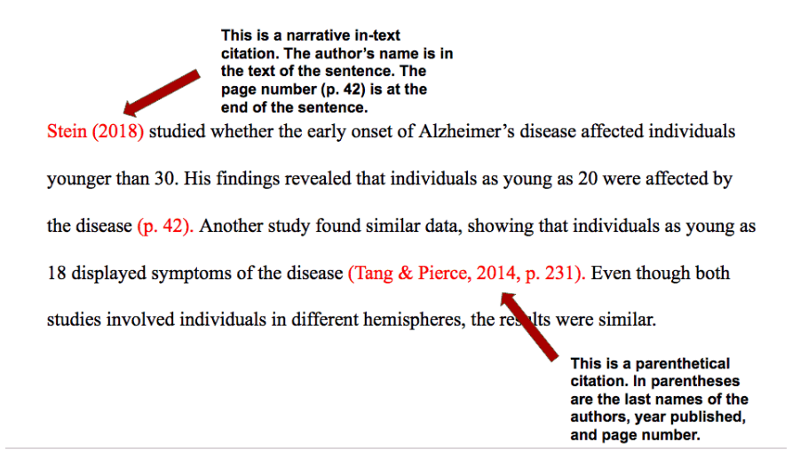
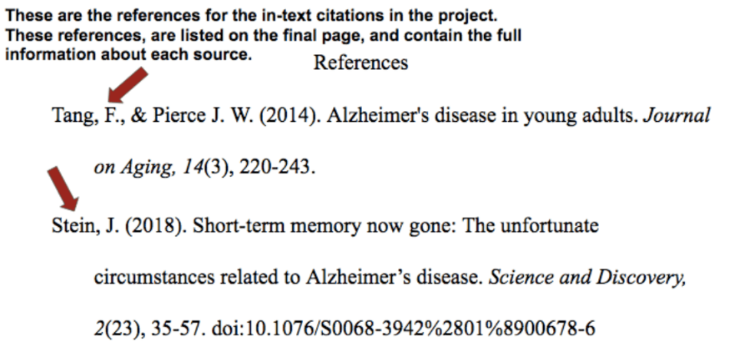
Compare: APA
In-text citation
References list
Citation Machine: American Psychological Association 6th Edition format citation generator for journal article. (2019). Citationmachine.net. https://www.citationmachine.net/apa

Slide 25
Do you need to memorize citation style?
The short answer is no.
The APA citation manual is over 400 pages
You do need to be familiar with the basic format for in-text citation and reference list citation
You also need to know how to access and use the many resources available to you for citing correctly

Slide 26
Types of in-text citations using APA
At the end or middle of a sentence in parenthesis:
This phenomenon is best referred to as a "cumulative
collaboration of evidence" (LaScotte & Peters, 2021, p. 49).
In a signal phrase somewhere in a sentence:
According to LaScotte and Peters (2021), the first challenge is ...in class (p. 57).
The problem, according to Chavez (2022), is that people do not...
Usually author's last name and date. May include a page number.

Slide 27
References page (should be on a separate page and in alphabetical order by last name.)
Herbert, M. C. (2003). Development and marketing strategies for
functional foods. AgBioForum, 6(1&2), 75-78. (Academic article)
Lorette, K. (2015). Cybersecurity for small businesses: A manual for
beginners. Random Pub. (book)
Perner, L. (2008). Adapting Brands. Food Marketing.
http://webcache.googleusercontent.com/search?q=cache:nDx-qnncJjgJ:www.consumerpsychologist.com/food_marketing.html&hl=en&strip=1.
(article in a website)

Slide 28
Basic format for books APA
BASIC FORMAT FOR BOOKS
Author, A. A. (Year of publication). Title of work: Capital letter also for subtitle. Publisher Name. DOI (if available)
Stoneman, R. (2008). Alexander the Great: A life in legend. Yale University Press.
https://owl.purdue.edu/owl/research_and_citation/apa_style/apa_formatting_and_style_guide/reference_list_books.html

Slide 29
Basic format for an academic article
Author, A. A., Author, B. B., & Author, C. C. (Year). Title of article. Title of
Periodical, volume number(issue number), pages. https://doi.org/xx.xxx/yyyy
Scruton, R. (1996). The eclipse of listening. The New Criterion, 15(3), 5–
13. (No DOI available).
Denny, H., Nordlof, J., & Salem, L. (2018). Understanding the needs and
expectations of working-class students in writing centers. Writing Center Journal, 37(1), 67–98. https://www.jstor.org/stable/26537363
https://owl.purdue.edu/owl/research_and_citation/apa_style/apa_formatting_and_style_guide/reference_list_books.html

Slide 30
Alphabetical order to last names or title
Pascoe, D. (2010)…
Stevens, F. H., Johnson, F, & Perry, J. (2022)...
Sverdrup, E. (2020)…
Westward ways to cook food. (2022)… (No author)
Which is the last name?
James Boone.
Joyce, James.

Slide 31
What is a research paper or case study?
A research paper is a common form of academic writing. Research papers require students and academics to locate information, take a stand on that topic, and provide support (or evidence) for that position in an organized report. They can be short, 4 – 10 pages, or 200+ pages.
The term research paper may also refer to a scholarly article that contains the results of original research or an evaluation of research conducted by others. Most scholarly articles must undergo a process of peer review before they can be accepted for publication in an academic journal.
Research papers must document the sources using a recognized style handbook.
Valdes, O. (2019). https://www.thoughtco.com/research-paper-1691912

Slide 32
What resources can you use to improve?
OWL Perdue APA References
https://owl.purdue.edu/owl/research_and_citation/apa_style/apa_formatting_and_style_guide/reference_list_basic_rules.html
APA Citation Manual or MLA Handbook
A Writer’s Reference or other combined citation manuals
Webster University Library Citation Guides
Reeg Academic Resource Center – Writing Center

Slide 33
Homework: 2 parts
Short answer based on book reading. Remember to "echo" and indent.
Make a References page
Use a citation guide source to create a short reference list from the items in the file.
The three sources are given to you.
You do not have to write a paper, just the References, using APA.
Remember to alphabetize the names according to the last name.
There are two articles and one book. See assignment.
Let's visit the library page to see examples.

Slide 34
References
Ahmad, S. (2016). The flipped classroom model to develop Egyptian EFL students’ listening
comprehension. English Language Teaching, 9, 166. http://dx.doi.org/10.5539/elt.v9n9.
Byram, M., & Wagner, M. (2018). Making a difference: Language teaching for intercultural
and international dialogue. Foreign Language Annals, 51, 140–151.
Chistyakova, T. B. (2016). Elektronnaya obrazovatel’naya sreda dlya kompetentnostno
-oriyentirovanogo obucheniya spetsialistov Nauka i Obrazovaniye. MGTU, 7, 230–241.
Retrieved November, 15, 2018, from http://technomag.edu.ru/doc/845179.html
Fedoruk, H. M. (2015). Formation of information and communication technologies
competence of future teachers in the course of vocational training. (Unpublished doctoral
dissertation). Mykhailo Kotsiubynsky Vinnitsa State Pedagogical University, Vinnytsia,
Ukraine.

Slide 35
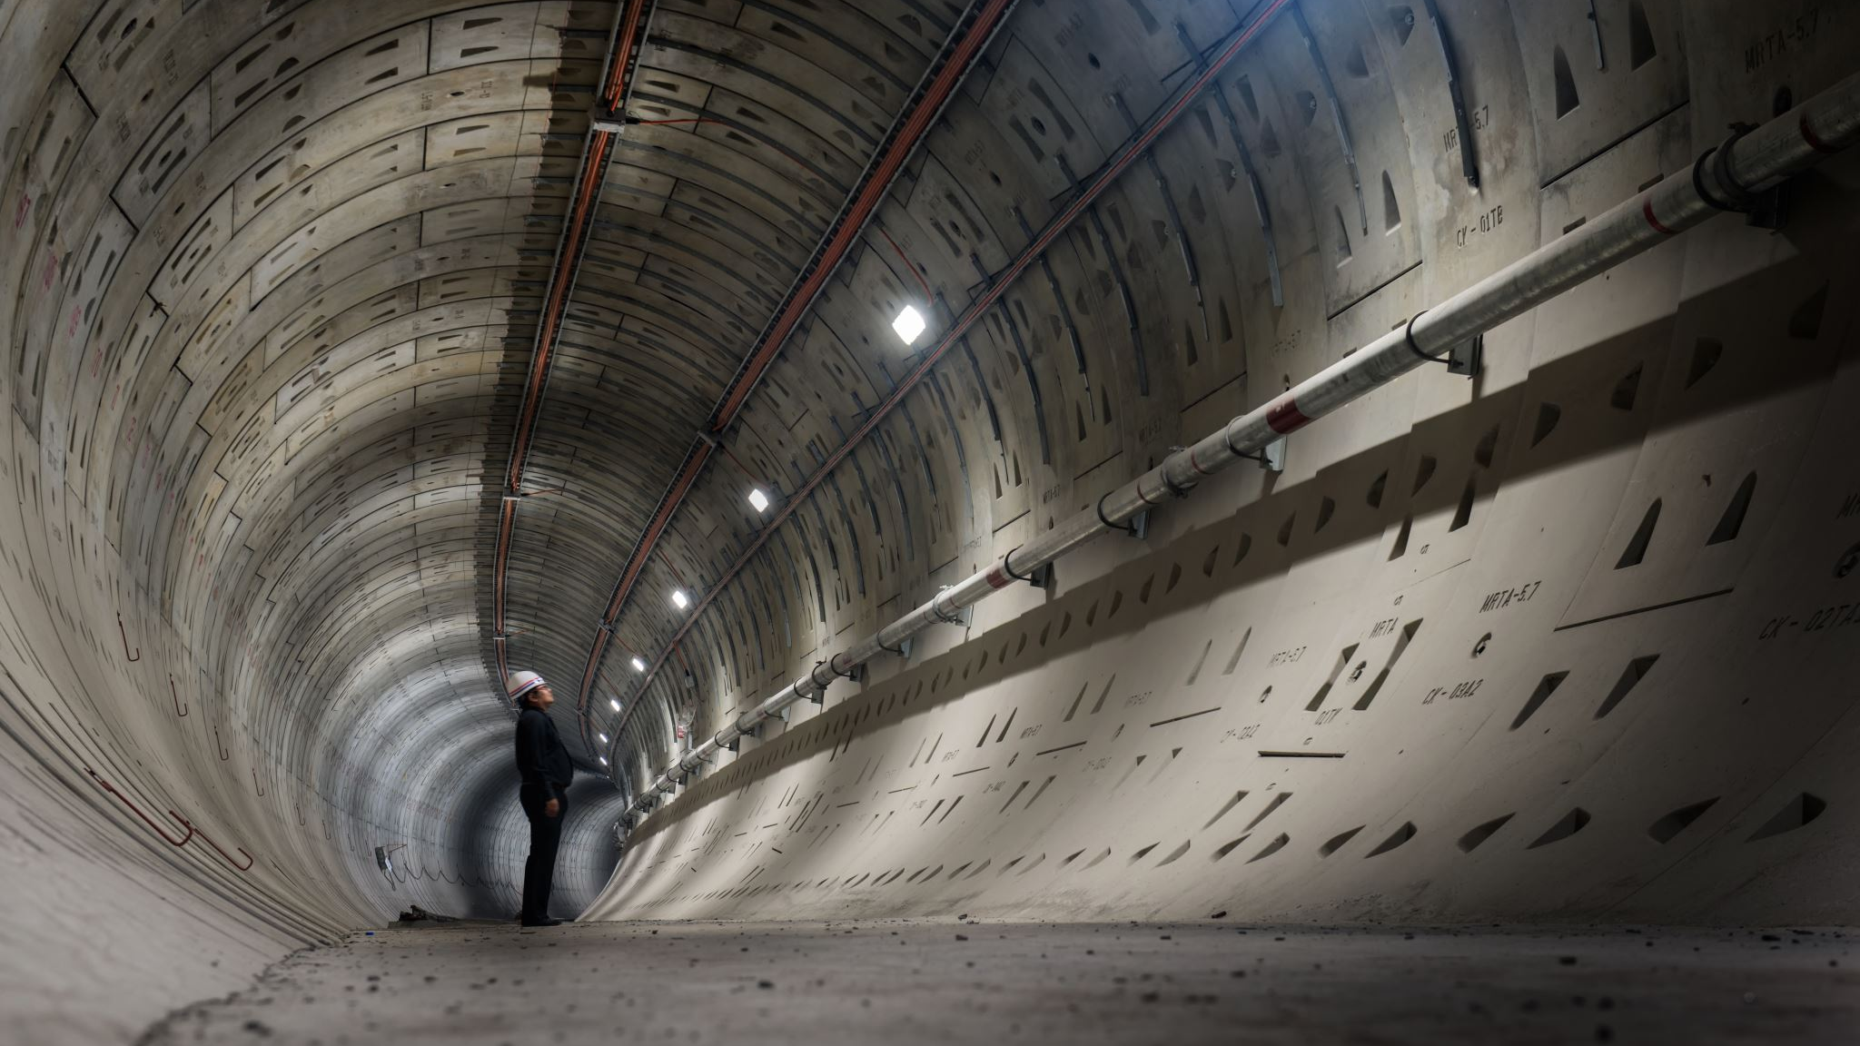
Questions and Make-up Work On Thursday. Extra Credit questions. One or two. You should review the power points beforehand. If you missed class, make sure you put your name in the chat so that I can give you attendance points. If you have a question about the homework, say hi and ask. Come on time.

Slide 36
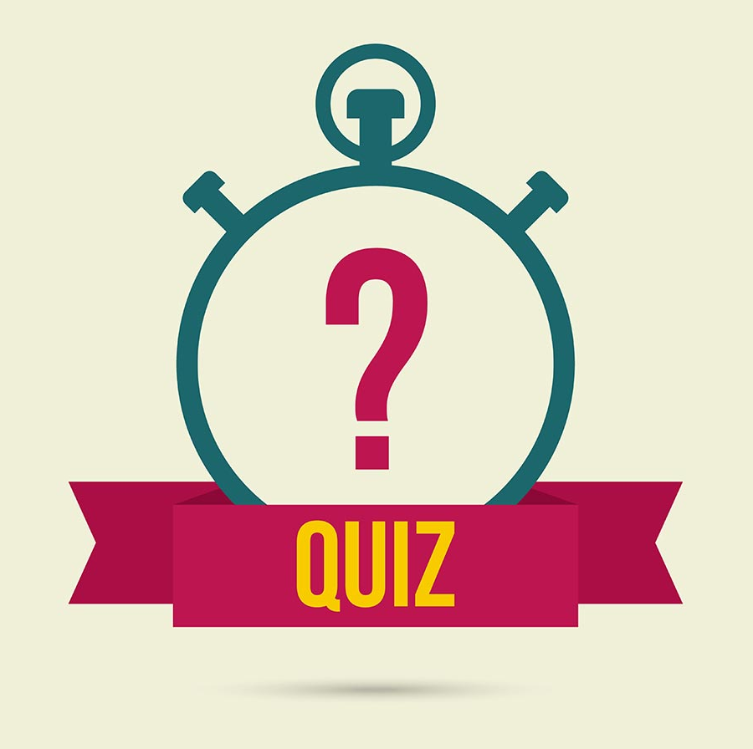
Participation Exit 2
Last five minutes of class.
Online Multiple Choice
Counts as participation and attendance for this week.
Found on Canvas.
This Photo by Unknown author is licensed under CC BY-SA.

